Slide 1
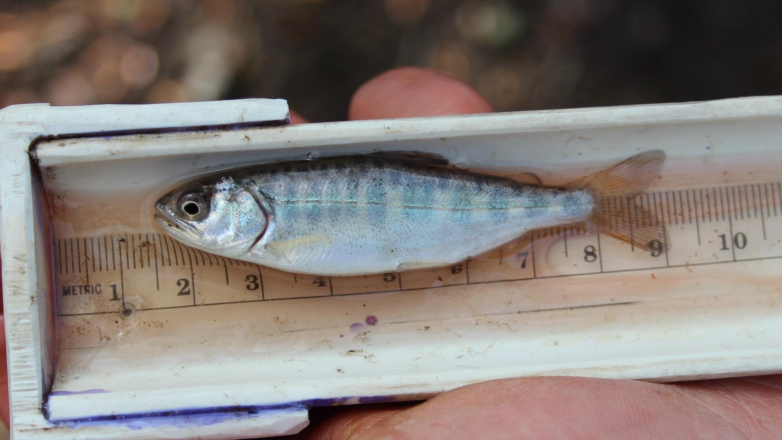
The Role of Non-Natal Tributaries in Green River Chinook Recovery
Chris Gregersen
Green-Duwamish Watershed Workshop
6/21/2023

Slide 2
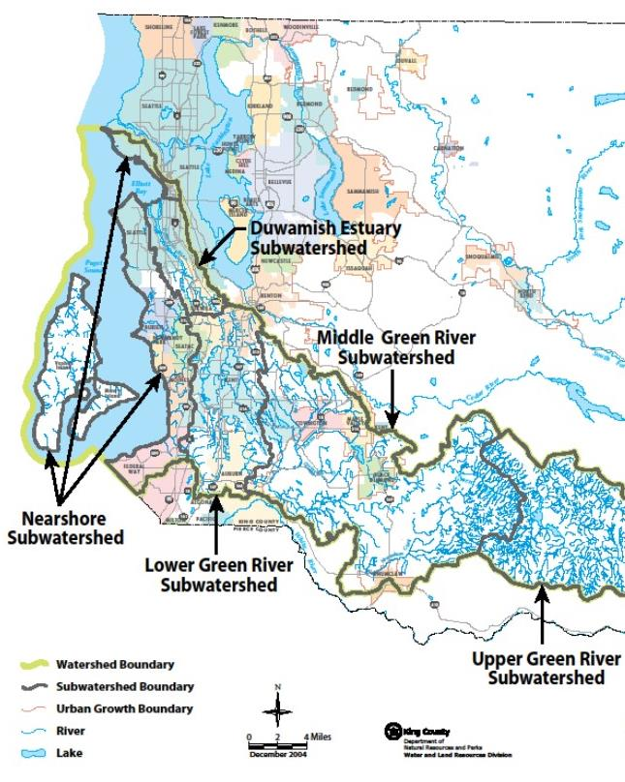
Background
On the path to Chinook Recovery…
What we know
Adults return to spawn in middle Green, rearing habitat limiting factor for juvenile production
Juveniles entering saltwater before rearing to larger size (less than 60mm) not surviving to adulthood
What we don’t (didn’t) know
What places provide critical rearing and flood refuge habitat in the heavily modified lower Green (e.g., non-natal tributaries)?
Notes:
This all begins with the listing of Puget sound chinook in 1999. In 2005, the WRIA 9 salmon habitat plan was approved which serves as a guide for chinook recovery in the basin. From this, the WRIA has devoted millions of dollars toward habitat restoration, and a portion of this goes towards research to help hone our ability to recover Chinook salmon (which is how this project got its start).
SO, adult Chinook salmon returning to the Green primarily spawn here in the middle Green. We know from WRIA funded research, that the rearing habitat here in the middle green is a limiting factor for how many smolt can be produced- this means that once this habitat reaches capacity with juveniles, that the bulk of the fish must leave to find habitat elsewhere.
We also know from WRIA funded research that juveniles that are leaving the river into saltwater before they reach about 60mm are not surviving to return as adults.
In between these, there are some things that we DON’T know.
Based on what I said, you’ve got a big population of fish leaving this area that are looking for rearing habitat. One of the big questions for the WRIA is how are fish using this lower Green area, and are there any places that are providing rearing habitat for Chinook in this area (such as non-natal tributaries).

Slide 3
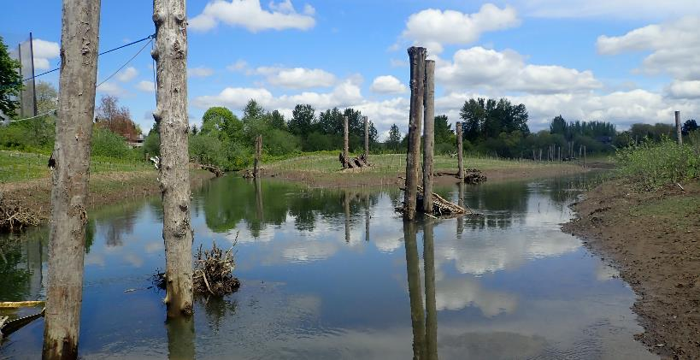
Why Tributaries?
Tributaries thought to be historically important rearing and flood refuge habitats in lower Green
Juvenile Chinook found to use non-natal tributaries in other locations
Lower Green trib in 1923 (White River Historical Society)
Habitat restoration opportunities in the lower Green are limited and expensive.
Tributary restoration may present more opportunities with unique benefits
Downey Side Channel – Lower Green
Notes:
When I say non- natal tributaries- I’m talking about the tributary streams in the lower Green where Chinook do not spawn, but juveniles born in the Middle Green might immigrate into them to use them for rearing habitat.
In the lower Green, its speculated that tributaries were historically important rearing and flood refuge habitat.
We also know that juvenile Chinook in general have been found to use non-natal tributaries in other basins. There are some incidental findings in some of the lower Green tributaries like Mill Creek and Mullen slough, but the spatial and temporal extent of this has been unkown.
So what if they are using tributaries? From a habitat restoration standpoint, restoration in the lower Green River is very expensive and complicated. You’ve got to excavate huge amounts of material to get down to the river level, and you’ve got flood regulations that add complexity and cost to projects. Also, this area is heavily industrialized- there isn’t an infitite number of places we can do projects, and property in this area is expensive.
Tributaries could present an alternative to this. Trib restoration could open up many more opportunities in the lower Green, and potentially come at a lower price tag (that is if fish are using them!)

Slide 4
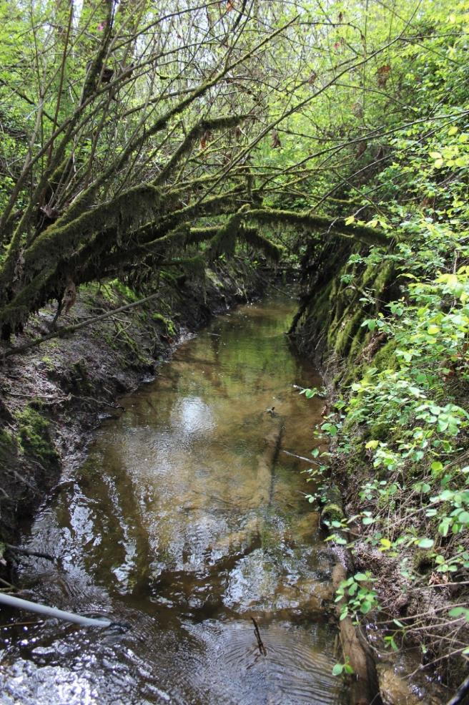
2019 Research
Do juvenile Chinook use non-natal streams in the lower Green for rearing?
    Fill data gap in WRIA 9 Salmon Habitat Plan
    Inform restoration priorities, project design
What patterns do we see for Chinook rearing in tributaries?
    Changes throughout rearing period
    Differences among tributaries
    PIT tagging
Midway Creek
Notes:
So, with this in mind- the purpose of this project is twofold
First, we want to know if juvenile Chinook are actually using these tributaries for rearing
Second, if they are using them, are there any spatial or temporal patterns occurring that could influence or prioritize restoration efforts

Slide 5
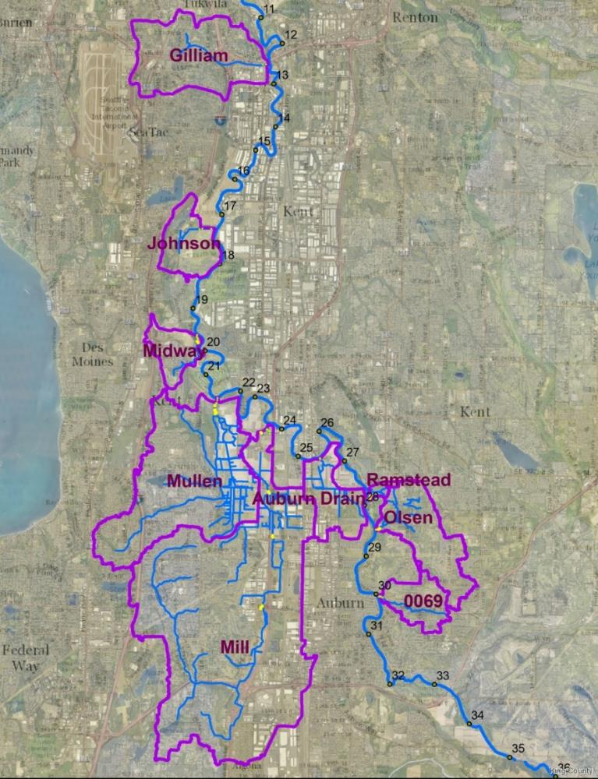
Are juvenile Chinook using these tributaries? Yes!
Streams Sampled
Trib 0069
Olson Creek
Ramstead Creek
NE Auburn Drain
Mill Creek
Mullen Slough
Midway Creek
Johnson Creek
Gilliam Creek
Chinook present
Trib 0069
Olson Creek
Ramstead Creek
NE Auburn Drain
Mill Creek
Mullen Slough
Midway Creek
Gilliam Creek
Notes:
So the big question, are Chinook actually using the tributaries. I’m happy to say that that is a definite YES! Out of the 9 streams sampled, juvenile Chinook were present in 8 of them.
Chinook were found in a wide range of sites- in the map here we’ve got 3 streams that are along the east wall of the valley that are more forested and higher gradient streams, 3 streams in the lower Green agriculture production district, and 3 streams along the west wall of the valley in the more urbanized areas. The only stream where Chinook were not found was Johnson Creek, here.

Slide 6
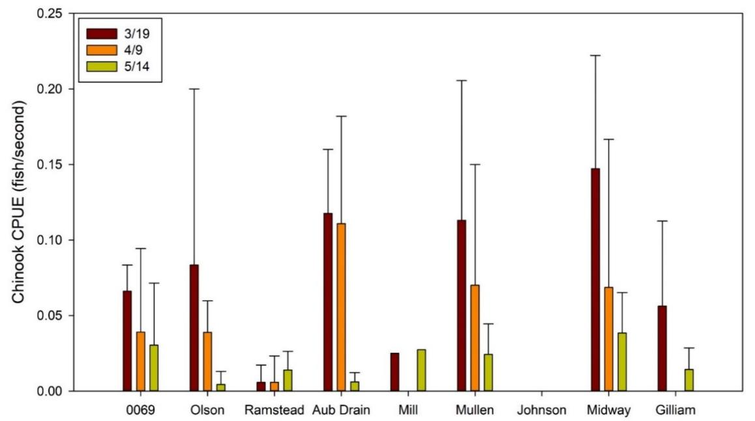
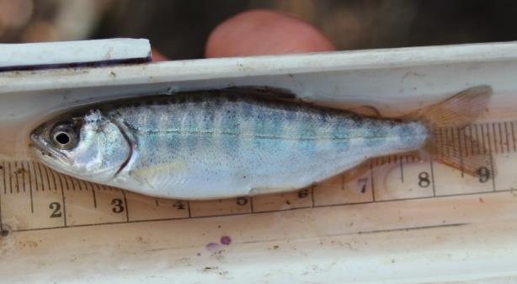
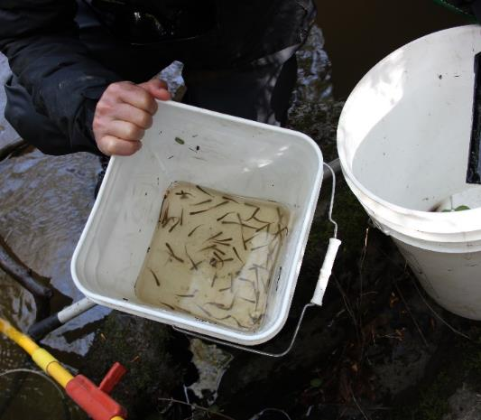
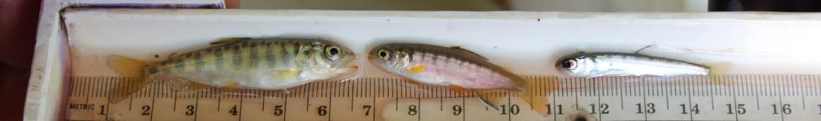
Chinook catch among tributaries and sampling dates
Chinook from Mullen Slough
Chinook CPUE among all habitat types and dates
Chinook (L), coho (M), and chum (R) from Olson Creek
Chinook and coho fry from NE Auburn
Notes:
So, digging a little deeper into this data, we can see that there are some spatial and temporal patterns. This is a graph that shows Chinook catch per unit effort for each stream and date (which is a standardized way to compare electrofishing data that divides the number of fish caught by the number of seconds spent electrofishing).
What we see here is that there is a definite decreasing trend over time, with the highest catch rates being observed in March, declining to May. Temporally, we can also see that some streams overall had higher catch rates than others. The two highest here being Mullen Slough and Midway Creek, while others had relatively low catch, like Ramstead creek, Mill Creek, and Gilliam creek.

Slide 7
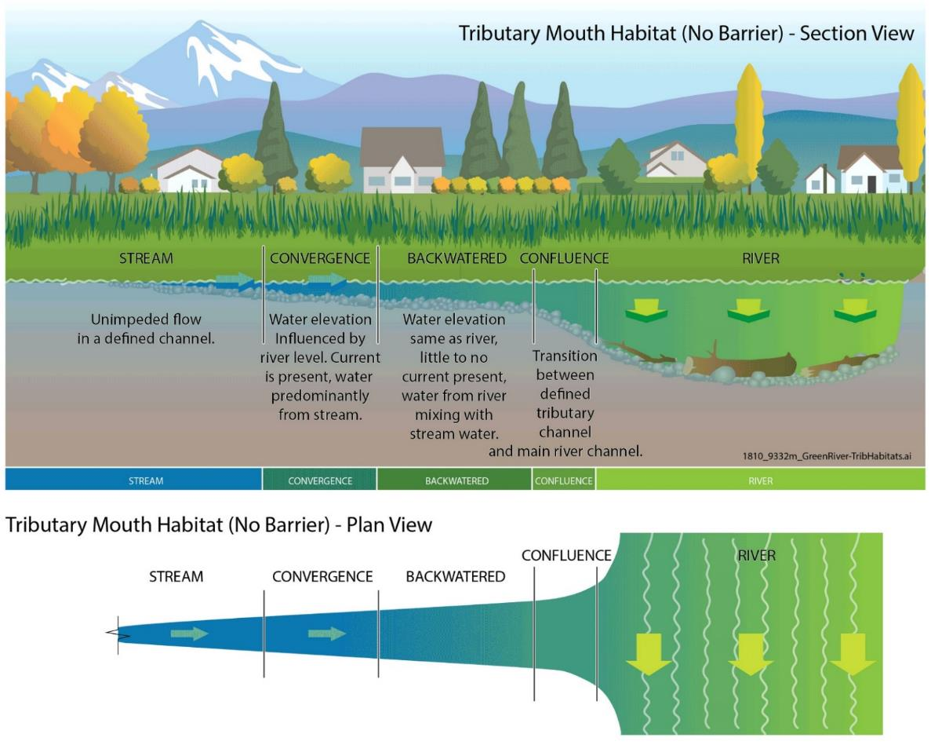
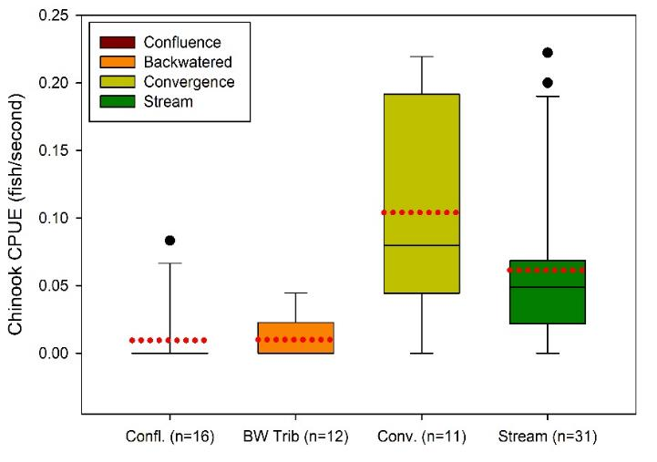
Are Chinook using tributary habitats differently?
Convergence and stream habitats saw highest densities of Chinook
Chinook found up to 500m upstream from the river!
Chinook catch by habitat type
Notes:
Going even deeper into this, our next question was whether or not Chinook are using habitat types differently.
During the course of the sampling, we identified 4 habitat types associated with tributaries along the lower Green. This includes stream habitat, explain, convergence habitat, explain, backwatered habitat, explain, confluence habitat, explain.
Comparing catch rates among all the habitat types, we can see a few patterns here. The convergence habitats and stream habitats had the highest mean catch per unit effort (that’s this red dotted line). Keep in mind though that capture efficiency is lower for these two habitats. I think the main take away here is that 1- fish are keying in on these transition areas, and 2- fish are using all of the habitats available to them.

Slide 8
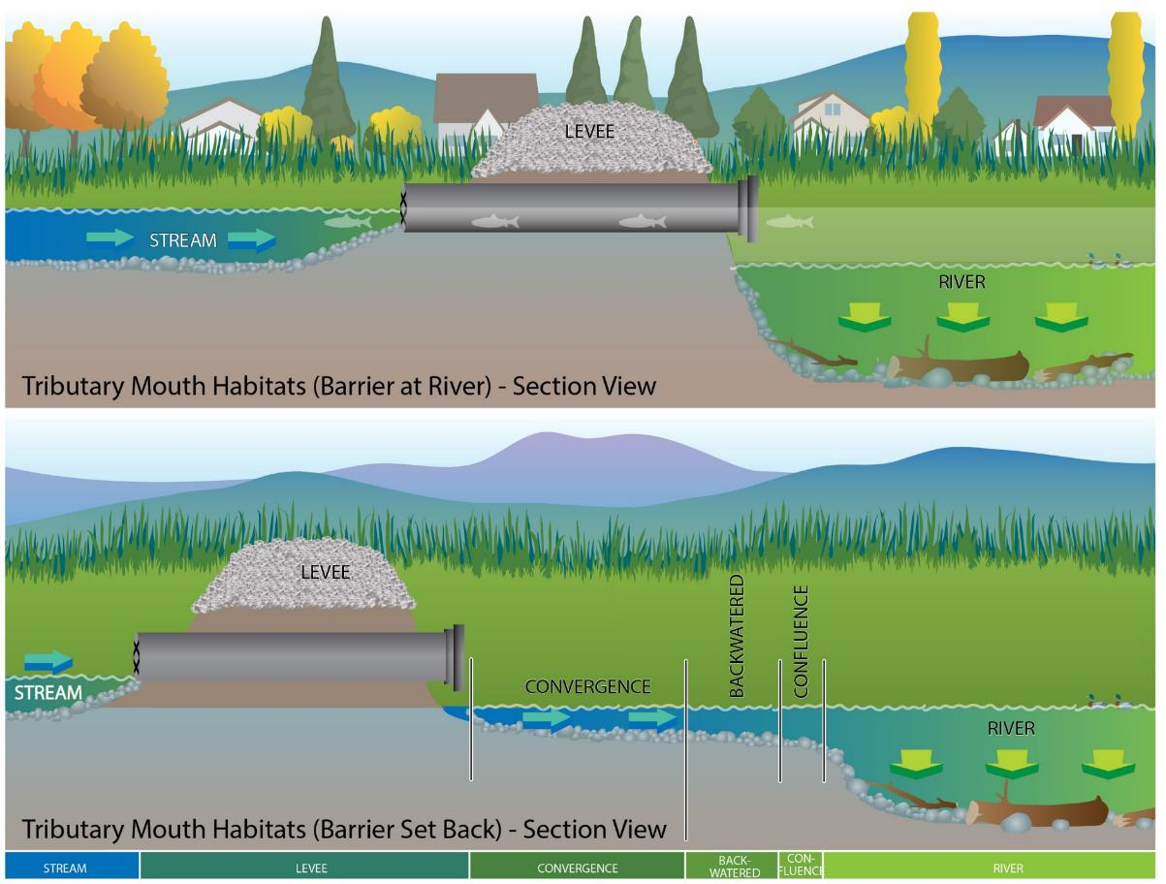
Barriers Greatly Impact Habitat and Access
Results
Not all flapgates created equally
Those accessed most were:
Perched (available at higher flows)
Those furthest from the river
The biggest
Notes:
Going even deeper into this, our next question was whether or not Chinook are using habitat types differently.
During the course of the sampling, we identified 4 habitat types associated with tributaries along the lower Green. This includes stream habitat, explain, convergence habitat, explain, backwatered habitat, explain, confluence habitat, explain.
Comparing catch rates among all the habitat types, we can see a few patterns here. The convergence habitats and stream habitats had the highest mean catch per unit effort (that’s this red dotted line). Keep in mind though that capture efficiency is lower for these two habitats. I think the main take away here is that 1- fish are keying in on these transition areas, and 2- fish are using all of the habitats available to them.

Slide 9
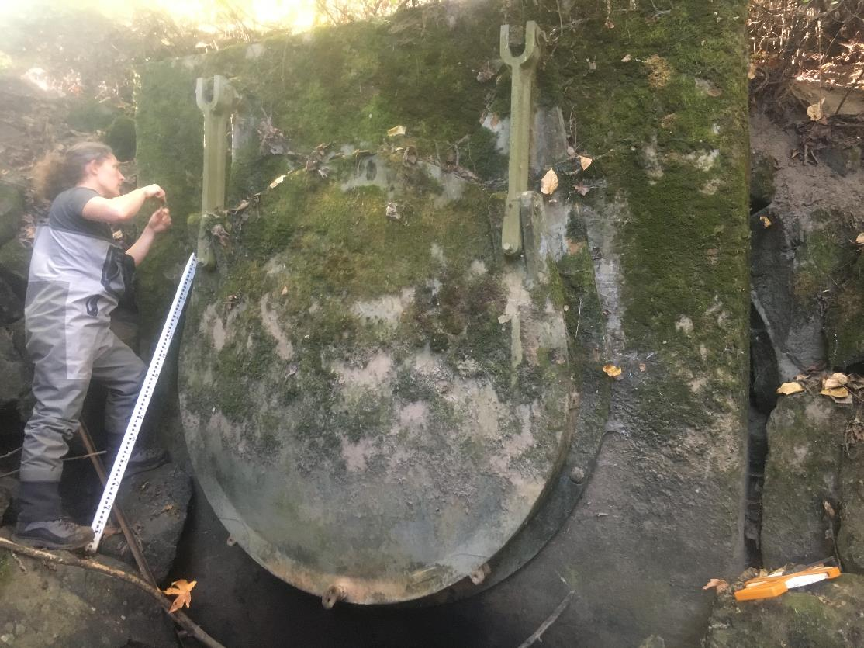
Barriers Greatly Impact Habitat and Access
NE Auburn Assessment
Flapgate Passable​
  January to June​
    2020: 7.1%​
    2021: 1.9%​
    2022: 4.3%​
  Excluding January​
    2020: 1.0%​
    2021: 0.3%​
    2022: 1.6%
Northeast Auburn Creek Flapgate
Notes:
Going even deeper into this, our next question was whether or not Chinook are using habitat types differently.
During the course of the sampling, we identified 4 habitat types associated with tributaries along the lower Green. This includes stream habitat, explain, convergence habitat, explain, backwatered habitat, explain, confluence habitat, explain.
Comparing catch rates among all the habitat types, we can see a few patterns here. The convergence habitats and stream habitats had the highest mean catch per unit effort (that’s this red dotted line). Keep in mind though that capture efficiency is lower for these two habitats. I think the main take away here is that 1- fish are keying in on these transition areas, and 2- fish are using all of the habitats available to them.

Slide 10
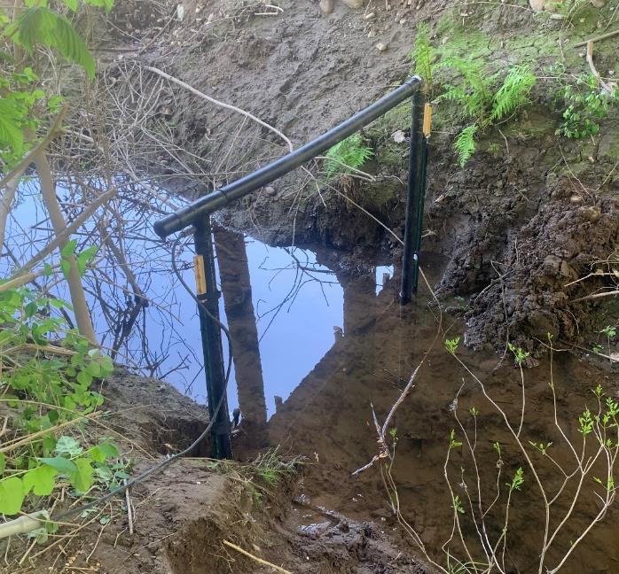
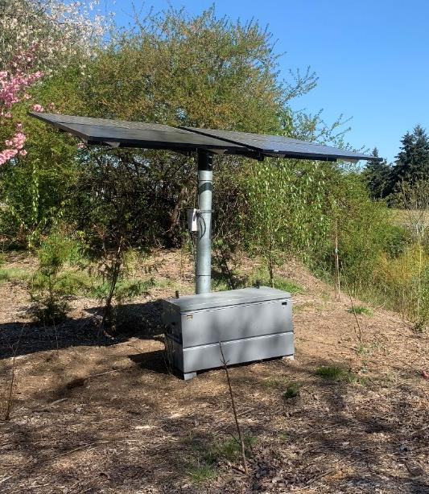
2021-2023 PIT Tag Research
Purpose
Install tracking antenna at the mouth of Midway Creek
Tag juvenile Chinook in the stream to better understand rearing
Tag Chinook in the river to understand use of the tributary
Midway Creek Antenna
Controller and Solar Panels
Notes:
Mentioned we also had a couple of antennas in tributaries.
Based on research these tribs are important habitat. But little known about fish staying or where they come from.
Put 2 antennas on 2 creeks. Tagged fish already in the stream
Good survival, 81% detected leaving.
No tagged fish entering tribs. These are most likely fry migrants that took refuge here in the winter and stayed.

Slide 11
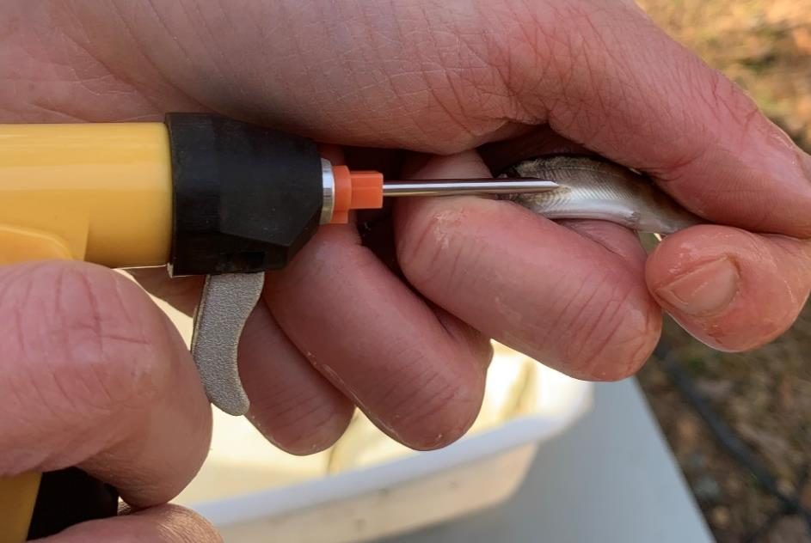
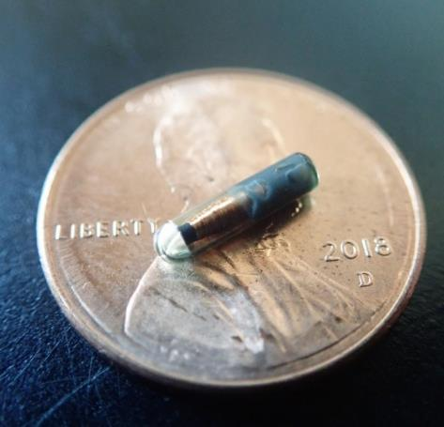
2021-2023 PIT Tag Research
Results
Non-natal tribs prove to be valuable rearing habitat
  32 fish tagged in Midway creek
  26 (81%) detected leaving early May
Zero fish tagged in the river detected entering Midway = likely fry entering early in the year
Tagging juvenile Chinook
9mm PIT tag
Notes:
Mentioned we also had a couple of antennas in tributaries.
Based on research these tribs are important habitat. But little known about fish staying or where they come from.
Put 2 antennas on 2 creeks. Tagged fish already in the stream
Good survival, 81% detected leaving.
No tagged fish entering tribs. These are most likely fry migrants that took refuge here in the winter and stayed.

Slide 12
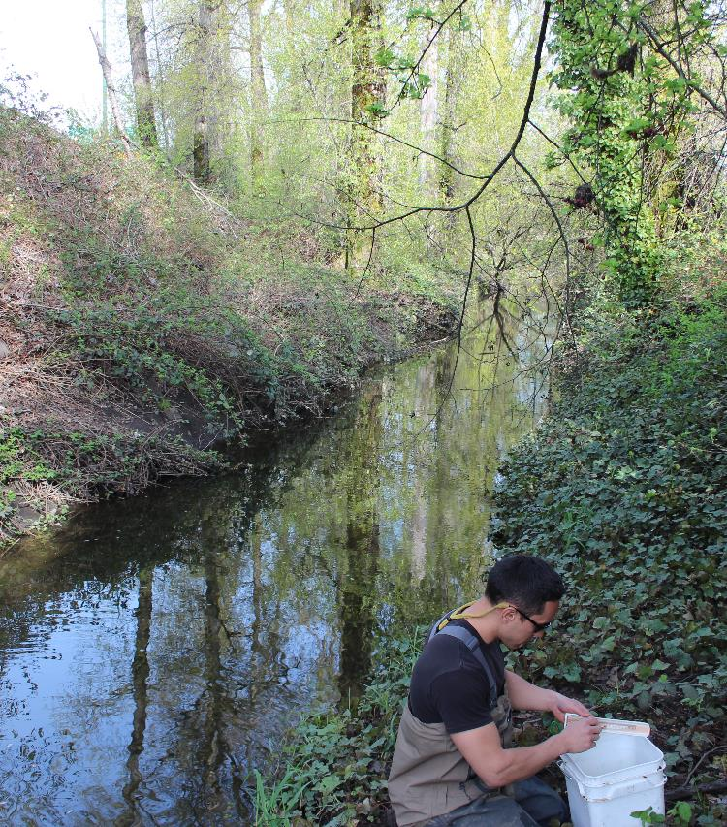
Research Key Takeaways
Results
Tribs providing long term rearing
Chinook observed above barrier in NE Auburn for 2 months
PIT tagged fish staying for up to 1 month
Tribs provide two important functions
Tribs accessed during floods, fish stay afterwards= flood refuge AND rearing habitat
High survival rate observed
High quality rearing
Notes:
Mentioned we also had a couple of antennas in tributaries.
Based on research these tribs are important habitat. But little known about fish staying or where they come from.
Put 2 antennas on 2 creeks. Tagged fish already in the stream
Good survival, 81% detected leaving.
No tagged fish entering tribs. These are most likely fry migrants that took refuge here in the winter and stayed.

Slide 13
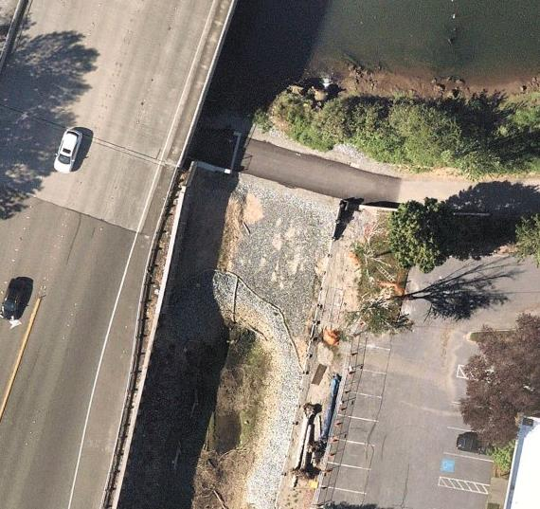
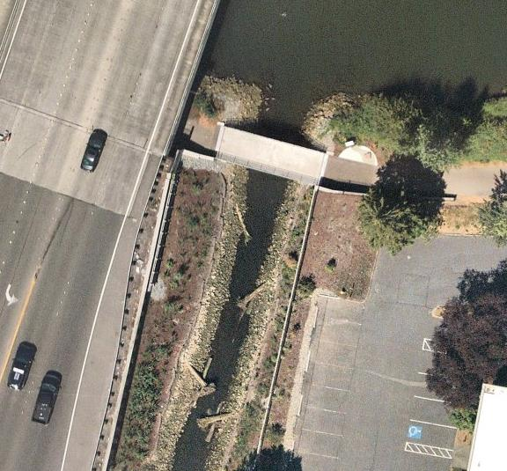
Re-Envisioning Chinook Recovery
What does tributary enhancement look like?
Removing barriers to access- Riverton Creek
Before
After
Notes:
Mentioned we also had a couple of antennas in tributaries.
Based on research these tribs are important habitat. But little known about fish staying or where they come from.
Put 2 antennas on 2 creeks. Tagged fish already in the stream
Good survival, 81% detected leaving.
No tagged fish entering tribs. These are most likely fry migrants that took refuge here in the winter and stayed.

Slide 14
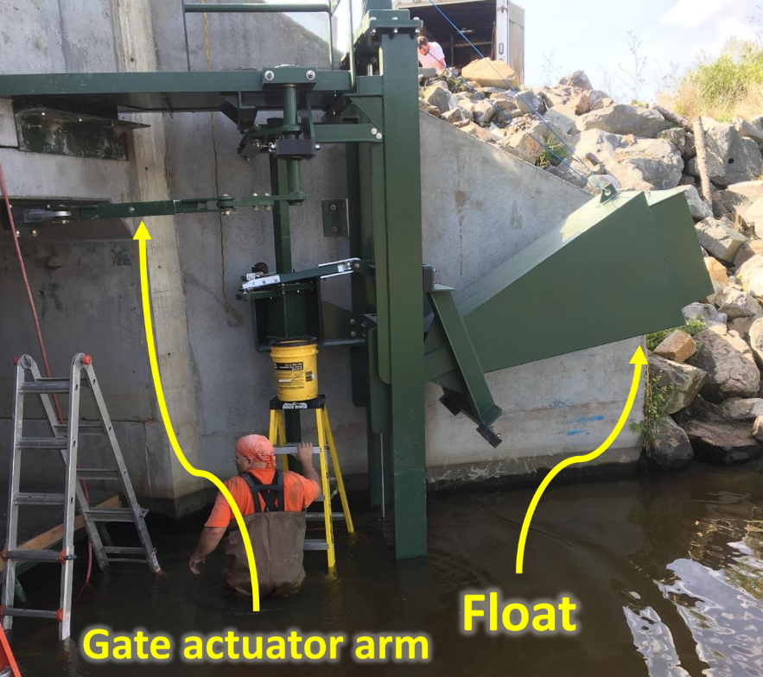
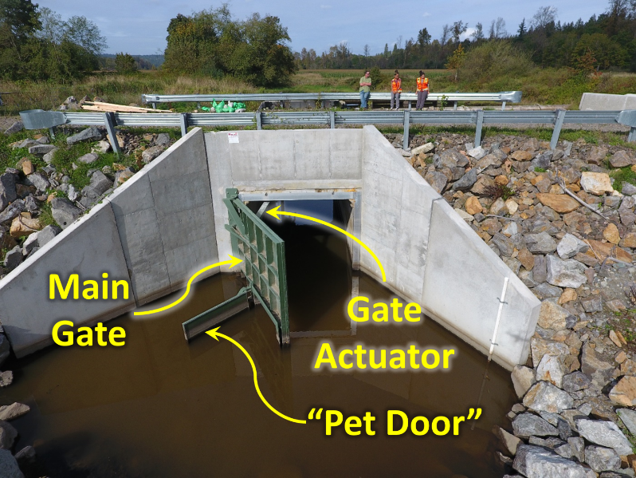
Re-Envisioning Chinook Recovery
What does tributary enhancement look like?
Replacing flapgates with fish friendly alternatives
Notes:
Mentioned we also had a couple of antennas in tributaries.
Based on research these tribs are important habitat. But little known about fish staying or where they come from.
Put 2 antennas on 2 creeks. Tagged fish already in the stream
Good survival, 81% detected leaving.
No tagged fish entering tribs. These are most likely fry migrants that took refuge here in the winter and stayed.

Slide 15
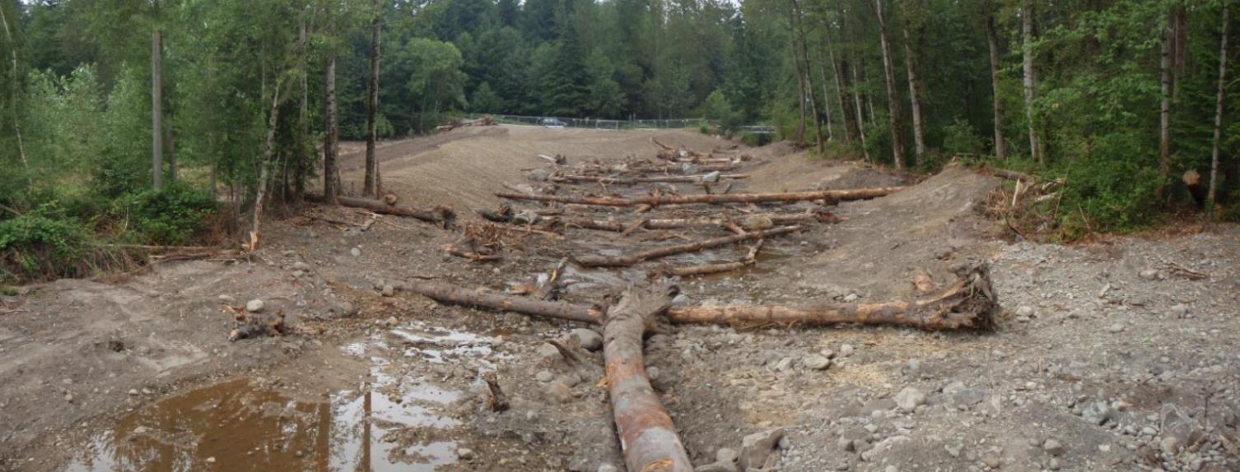
Re-Envisioning Chinook Recovery
What does tributary enhancement look like?
Restoring degraded stream habitat
Lower Boise Creek channel restoration
Notes:
Mentioned we also had a couple of antennas in tributaries.
Based on research these tribs are important habitat. But little known about fish staying or where they come from.
Put 2 antennas on 2 creeks. Tagged fish already in the stream
Good survival, 81% detected leaving.
No tagged fish entering tribs. These are most likely fry migrants that took refuge here in the winter and stayed.

Slide 16
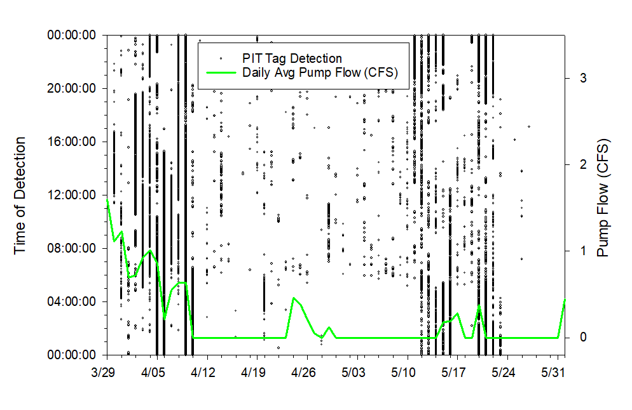
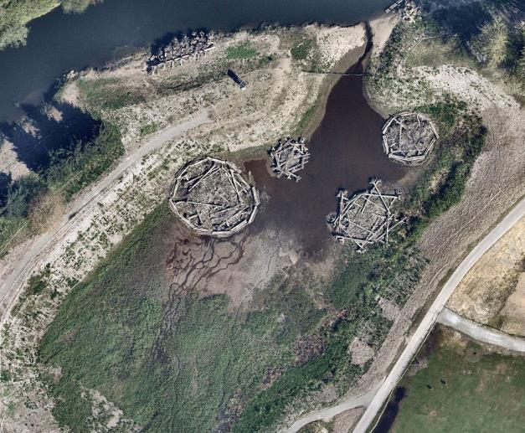
Re-Envisioning Chinook Recovery
What does tributary enhancement look like?
Engineered Solutions
Lower Russel backwater artificial tributary
Notes:
Mentioned we also had a couple of antennas in tributaries.
Based on research these tribs are important habitat. But little known about fish staying or where they come from.
Put 2 antennas on 2 creeks. Tagged fish already in the stream
Good survival, 81% detected leaving.
No tagged fish entering tribs. These are most likely fry migrants that took refuge here in the winter and stayed.

Slide 17
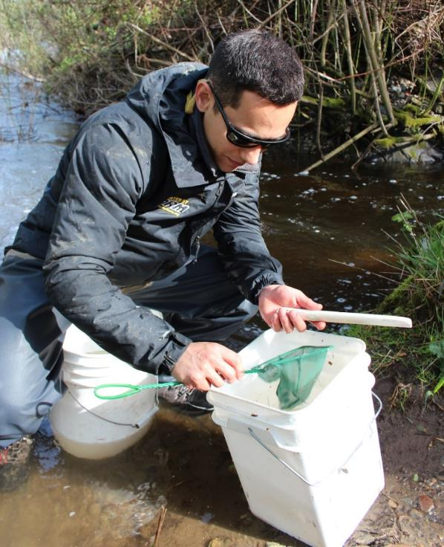
Salmon Recovery Implications
What does this work mean? | What can we do?
Tributaries are important for juvenile Chinook rearing in the lower Green | Support tributary enhancement projects
Even impaired streams are capable of supporting juvenile Chinook rearing | Provide access to existing trib habitat regardless of habitat quality
Juvenile fish passage barriers important consideration for Chinook | Identify and address juvenile passage barriers
Variability in flapgate performance for juvenile Chinook | Assess flapgate performance and identify potential fixes/retrofits
Josh Kubo measuring juvenile Chinook at Olson Creek
Notes:
This is just a broad overview of the data, but when we boil it down, what do these results mean in terms of Chinook recover, and what can we do with it?
Well first off we now know that tributaries are important for juvenile Chinook rearing in the lower Green (and likely throughout the basin). From this, we should further support tributary enhacement projects
Also, even impaired streams support Chinook rearing. Like I just mentioned, Auburn Drain, which had Chinook in it for at least 2 months- is an ag drainiage ditch. Looking at landcover, it’s about 1% forested. On the other spectrum, Gilliam creek, which also had chinook using it, is about 88% urbanized with 42% impervious area! These fish don’t need pristine habitat, they just need something. From this though, we can work on providing access to all water bodies, even those we don’t typically think of as Chinook habitat.
Also a very important consideration- fish passage barriers are important for juveniles. We generally think of them in terms of adults, but when it comes to Chinook when adults aren’t actually spawning in these tribs- fish passage for the juveniles is actually more important in terms of recovery. Identifying and addressing these barriers is an important next step.
Finally, not all flapgates are created equal. There appears to be high variability in how they function to allow fish upstream. From this, we can assess flapgate performance and identify fixes or retrofits that would improve passability.

Slide 18
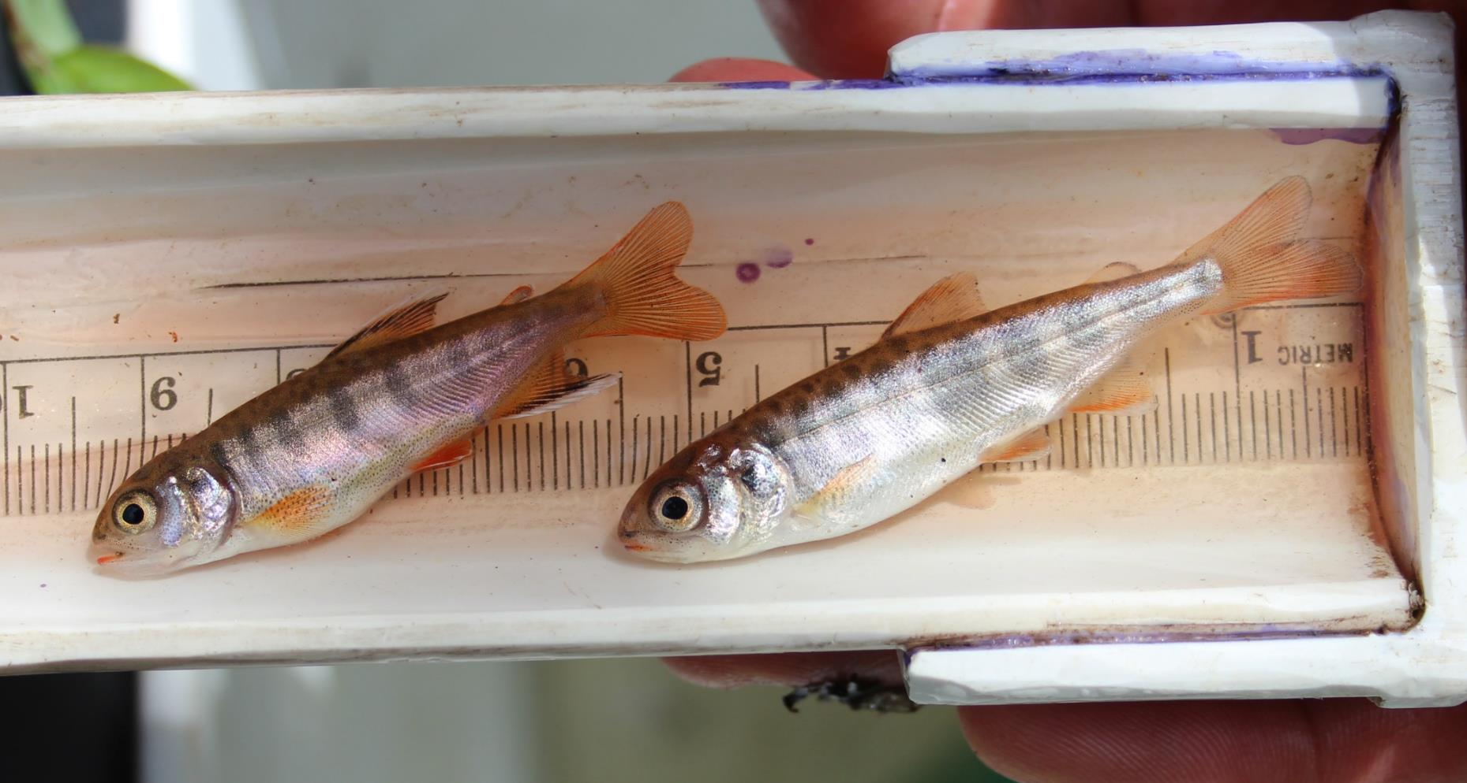
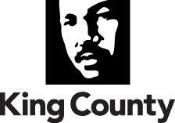
Thank you.
Chris Gregersen, Fisheries Ecologist
Chris.Gregersen@kingcounty.gov
(206) 477 4699
Water and Land Resources Division
King County Department of
Natural Resources and Parks
Notes:
With that, I would also like to thank WRIA 9, Josh Kubo for his field expertise, and Elissa Ostergaard for helping to push for this study.

